Slide 1
LEARNING TO BECOME A BETTER WRITER
LITTLE THINGS CAN MAKE A BIG DIFFERENCE!!
MEGA MENTORS
SHIRL H. LEVERETT, PH.D.
JULY 2020

Slide 2
CHECK YOUR SPELLING!!!
USE THE TOOLS ON YOUR PHONE, COMPUTER, OR TABLET TO CHECK YOUR SPELLING!
USE COMPLETE SENTENCES ON SCHOOL ASSIGNMENTS; YOU’RE NOT TEXTING A BUDDY!!
READ WHAT YOU HAVE WRITTEN BEFORE PRESSING THE SEND BUTTON! YOU CAN’T GET IT BACK AFTER PRESSING .

Slide 3
WATCH YOUR GRAMMAR!
IF YOU START WRITING IN THE PRESENT TENSE, STAY IN THE PRESENT TENSE.
IF YOU BEGIN IN THE PAST TENSE, CONTINUE IN THE PAST TENSE.
DON’T MIX OR USE A COMBINATION OF DIFFERENT TENSES IN THE SAME PARAGRAPH.

Slide 4
IMPROVE YOUR VOCABULARY!
DOES YOUR WRITING REFLECT THE GRADE YOU’RE IN? IS YOUR WRITING BETTER THAN A FIFTH GRADER?
USE THE TOOLS YOU ALREADY HAVE TO IMPROVE YOUR WRITING:
ONLINE DICTIONARY
THESAURUS
GRAMAR CHECK

Slide 5
COMMON WRITING MISTAKES
LACK OF VARIETY –EVERY SENTENCE USES THE SAME PATTERN
SENTENCE FRAGMENTS
RUN-ON SENTENCES
INCORRECT PUNCTUATION
SUBJECTS & VERBS DON’T AGREE
NO USE OF COMPOUND SENTENCES

Slide 6
WHAT’S THE PROBLEM?
Example: Getting my hair done this afternoon.
What’s the problem?
Correction?
Example: I play video games I have to finish studying.
PROBLEM?
Correction?
Example: My mom work two jobs.
Problem?
Correction?
Example: Who made that basket.
Problem?
Correction?

Slide 7
WHAT’S THE PROBLEM?
Example: Trey works part-time. Trey saves his money. Trey seems antisocial. Trey is just tired.
Problem?
Correction?
Example: I enjoy reading, watching NBA games, playing board games, and playing the piano. Seth Curry is my favorite player. I read three books when I go on vacation. Since the pandemic, I spend more time playing the piano.
Problem?
Correction?

Slide 8
“THE EARLY BIRD GETS THE WORM”
TURN YOUR ASSIGNMENT IN A DAY OR TWO BEFORE IT’S DUE.
ASK YOUR TEACHER, OR ANOTHER TEACHER TO CRITIQUE WHAT YOU HAVE ALREADY WRITTEN BEFORE TURNING IN YOUR ASSIGNMENT FOR A GRADE.

Slide 9
www.time4writing.com/writing-resources/writing-problems-high-school/

Slide 10
BE CERTAIN THAT YOU UNDERSTAND THE WRITING PROMPT
ANSWER THE QUESTION THAT WAS ASKED!!!
ANSWER THE QUESTION THAT WAS ASKED!!!
WRITE WITH CLARITY!
WILL THE READER CLEARLY UNDERSTAND YOUR THOUGHTS?
ARE YOUR THOUGHTS RUNNING TOGETHER, AND DIFFICULT TO UNDERSTAND?

Slide 11
SPICE IT UP!!!
IS YOUR WRITING BORING? DOES IT SOUND LIKE EVERY OTHER PERSON’S RESPONSE?
WHAT MAKES YOUR WRITING STAND OUT???
USE DESCRIPTIVE WORDS AND FIGURATIVE LANGUAGE IN YOUR WRITING.
MAKE THE READER EAGER TO READ YOUR WRITING.

Slide 12
USE FIGURATIVE SPEECH TO DESCRIBE THIS ITEM.

Slide 13
DESCRIBE THIS PHOTO FIGURATIVELY.

Slide 14
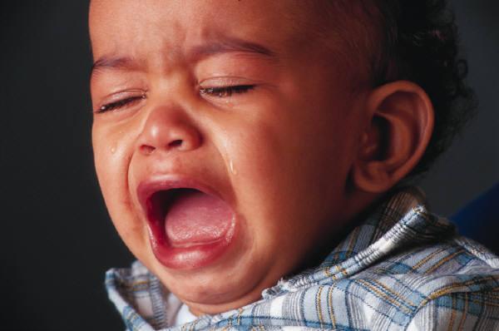
GIVE A FIGURATIVE DESCRIPTION OF THIS CHILD.

Slide 15
ENJOY THE WRITING PROCESS
YOU WILL GET BETTER AT IT!

